Slide 1
The Human Element
CADA Area C Conference Fall 2014

Slide 3
YOU’LL NEVER BE ANYTHING
GAY
CHINK
YOU SUCK
FAT
WETBACK
I HATE YOU
GHETTO
GEEK
LOSER
STUPID
DUMB
HO
SLUT
FAGGOT
SKINNY
UGLY
NERD
POOR
NOBODY
LONER
IS IT BECAUSE I’M BLACK?

Slide 4
Friendship
I’m proud of you
You’re so kind
AWESOME
YOU ROCK
I believe in you
Good Job
FUNNY
Thank You
SUPER
WAY TO GO
You CAN do it
WOW
Beautiful
have a nice day
LEADER
I ♥ U
SMART
You make me smile
I couldn’t do it without you

Slide 5
People see me as:
The white Student Body President
The geek in the corner
The rich kid with an iPhone
The stupid gay kid
Nobody

Slide 6
But in reality, I AM:
Just like you
A hard-worker who studies all night to get good grades to go to college
Working to pay for my AP tests and afford my college tuition
Trying to find my identity and go to school
Trying to become somebody

Slide 7
Ultimately…

Slide 8
Everyone, no matter who they are, where they came from, or what they look like, has one thing in common ; They are HUMAN.
Fresno Unified School District
Student Advisory Board 2012-13

Slide 9
How we got here:
The words ‘anti-bullying’ were not creating the change we wanted to see
Tired of hearing the slurs, hateful words, and feeling and observing actions
We wanted to make change
Kindness is a culture
Vision: To protect and support each other through kindness as a culture

Slide 10
Where we want 2 go:
HUMAN Element = Kindness/Awareness/Strength
Promote change through a kindness culture campaign
FUSD → City of Fresno → California
Marketing Ideas: posters, t-shirts, post cards, stickers, bracelets, local news, social media, and The Ellen Show
FUSD School Site Plans
City of Fresno Plans
Rallies
Human Element theme days/weeks
Kindness Curriculum
Videos
High-5 hallways
Smile Days
Guest Speakers…etc
Proclamation of HUMAN Element Day
Local businesses showcasing
posters
bracelets
stickers
We need the city’s support and media coverage of citizens in Fresno being kind to each other through various actions

Slide 11
Things We Need
A partnership with the FBC/FUSD Leadership in helping to promote HUMAN Element awareness city wide and/or support of the marketing and site based materials and a connection to Mayor Swearengin
Ink and paper for poster printer or a business to donate poster printing for us
Shirts and ink for printing screen or a business to donate their t-shirt printing services
Support of Human Element bracelets

Slide 12
Things We’ve Learned
Fresno Business Council Voted to Support
The HUMAN Element Campaign
Recommendations from FBC:
Billboards and other Marketing Materials
Partnership with Fresno County Schools
Partner with all Elected Stakeholders
Lessons learned though SAB/FBC Presentations:
Future Partnership with City of Fresno/Mayor
Signage on City Busses/School Busses
Budget Plans and Finalize the Marketing Materials
Support of Human Element Bracelets

Slide 13
A small action can start a chain reaction – be the change

Slide 15
The Myth of the Light Bulb Idea
By:Richard Banfield Date posted: December 18, 2011
Some days, it’s hard to feel creative and inspired. Days, or even weeks, like that can come at any time…
There is a pervasive myth that genius or flashes of creativity come in an instant. In some blinding moment of creativity, an idea for something amazing is revealed to you. That belief couldn’t be further from the truth. Creativity is never blocked. Creativity is just hiding behind something called perseverance and hard work.
The prevailing myth is that creativity strikes like lightning or dries up like water in the desert. So common is this fallacy that it has managed to create its own list of acronyms and visual icons. The light bulb, the striking lightning and the mad scientist “Eureka!” moment are the most nauseating.
Being Comfortable with Making Mistakes
Creativity is not a light switch you can turn on and off. It’s a process. Generally, it’s a hard-earned process that includes a string of dead ends or failed attempts. To be creative is to be comfortable with making mistakes. Creativity requires its students to get out of their comfort zones and stop seeking instant inspiration.
Creativity, in that true sense of the word — to create, is an evolutionary process. It’s a series of experiments. It can take a long time and require a lot of patience. It rarely comes in a flash.
- See more at: http://www.agencypost.com/the-myth-of-the-light-bulb-idea/#sthash.GulnsRq3.dpuf

Slide 16
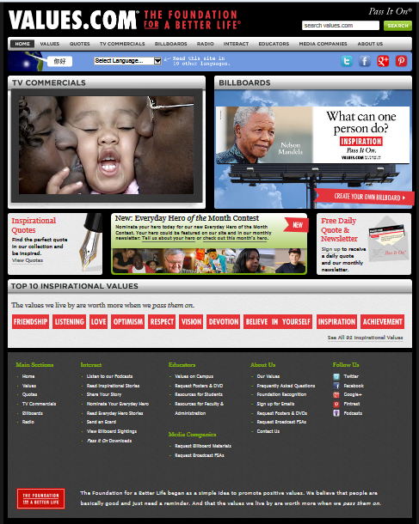
Our Campaign Proposal:
Developing the Human Element
Make Every Day Count = Anchor
Use Print Media and FUSD Website
Continue Attention to Attendance
Continue Letters Home/Phone Calls
Continue Teacher motivation
Use Values.com as a framework:
Add Commercials
Fliers
Billboards
Stories/Inspirational Quotes
Contests
School Websites
Social Media
Facebook
Twitter
Instagram
Our Campaign Outcomes...

Slide 17
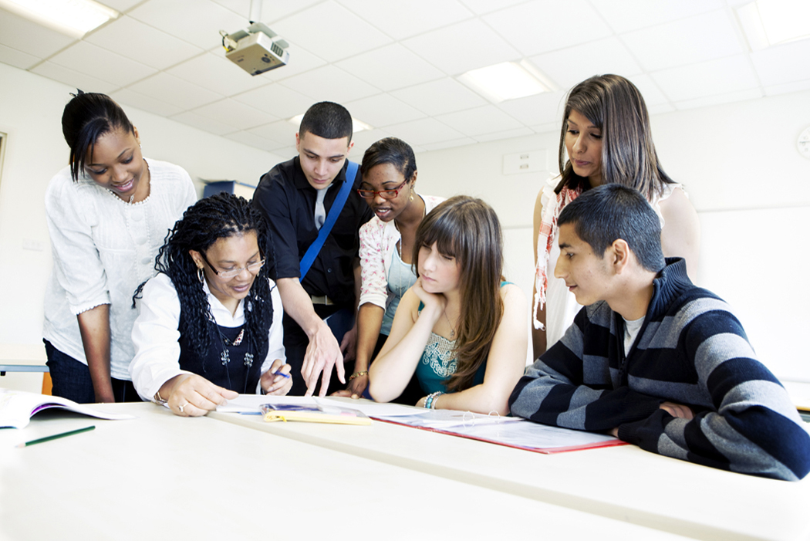
Our Campaign Outcomes...
Engagement
Pass it On
Creativity
Build NEW Relationships
Buy-In
Have FUN !
Connect with Each Other
Work Together
Talk to Adults
Hold
each other accountable
But we can’t be afraid to use:

Slide 18
SOCIAL MEDIA
@
#humankindbeboth
Check out: http://cbessoneducation.blogspot.com
http://www.howcast.com/guides/594-How-to-Use-Social-Media

Slide 19
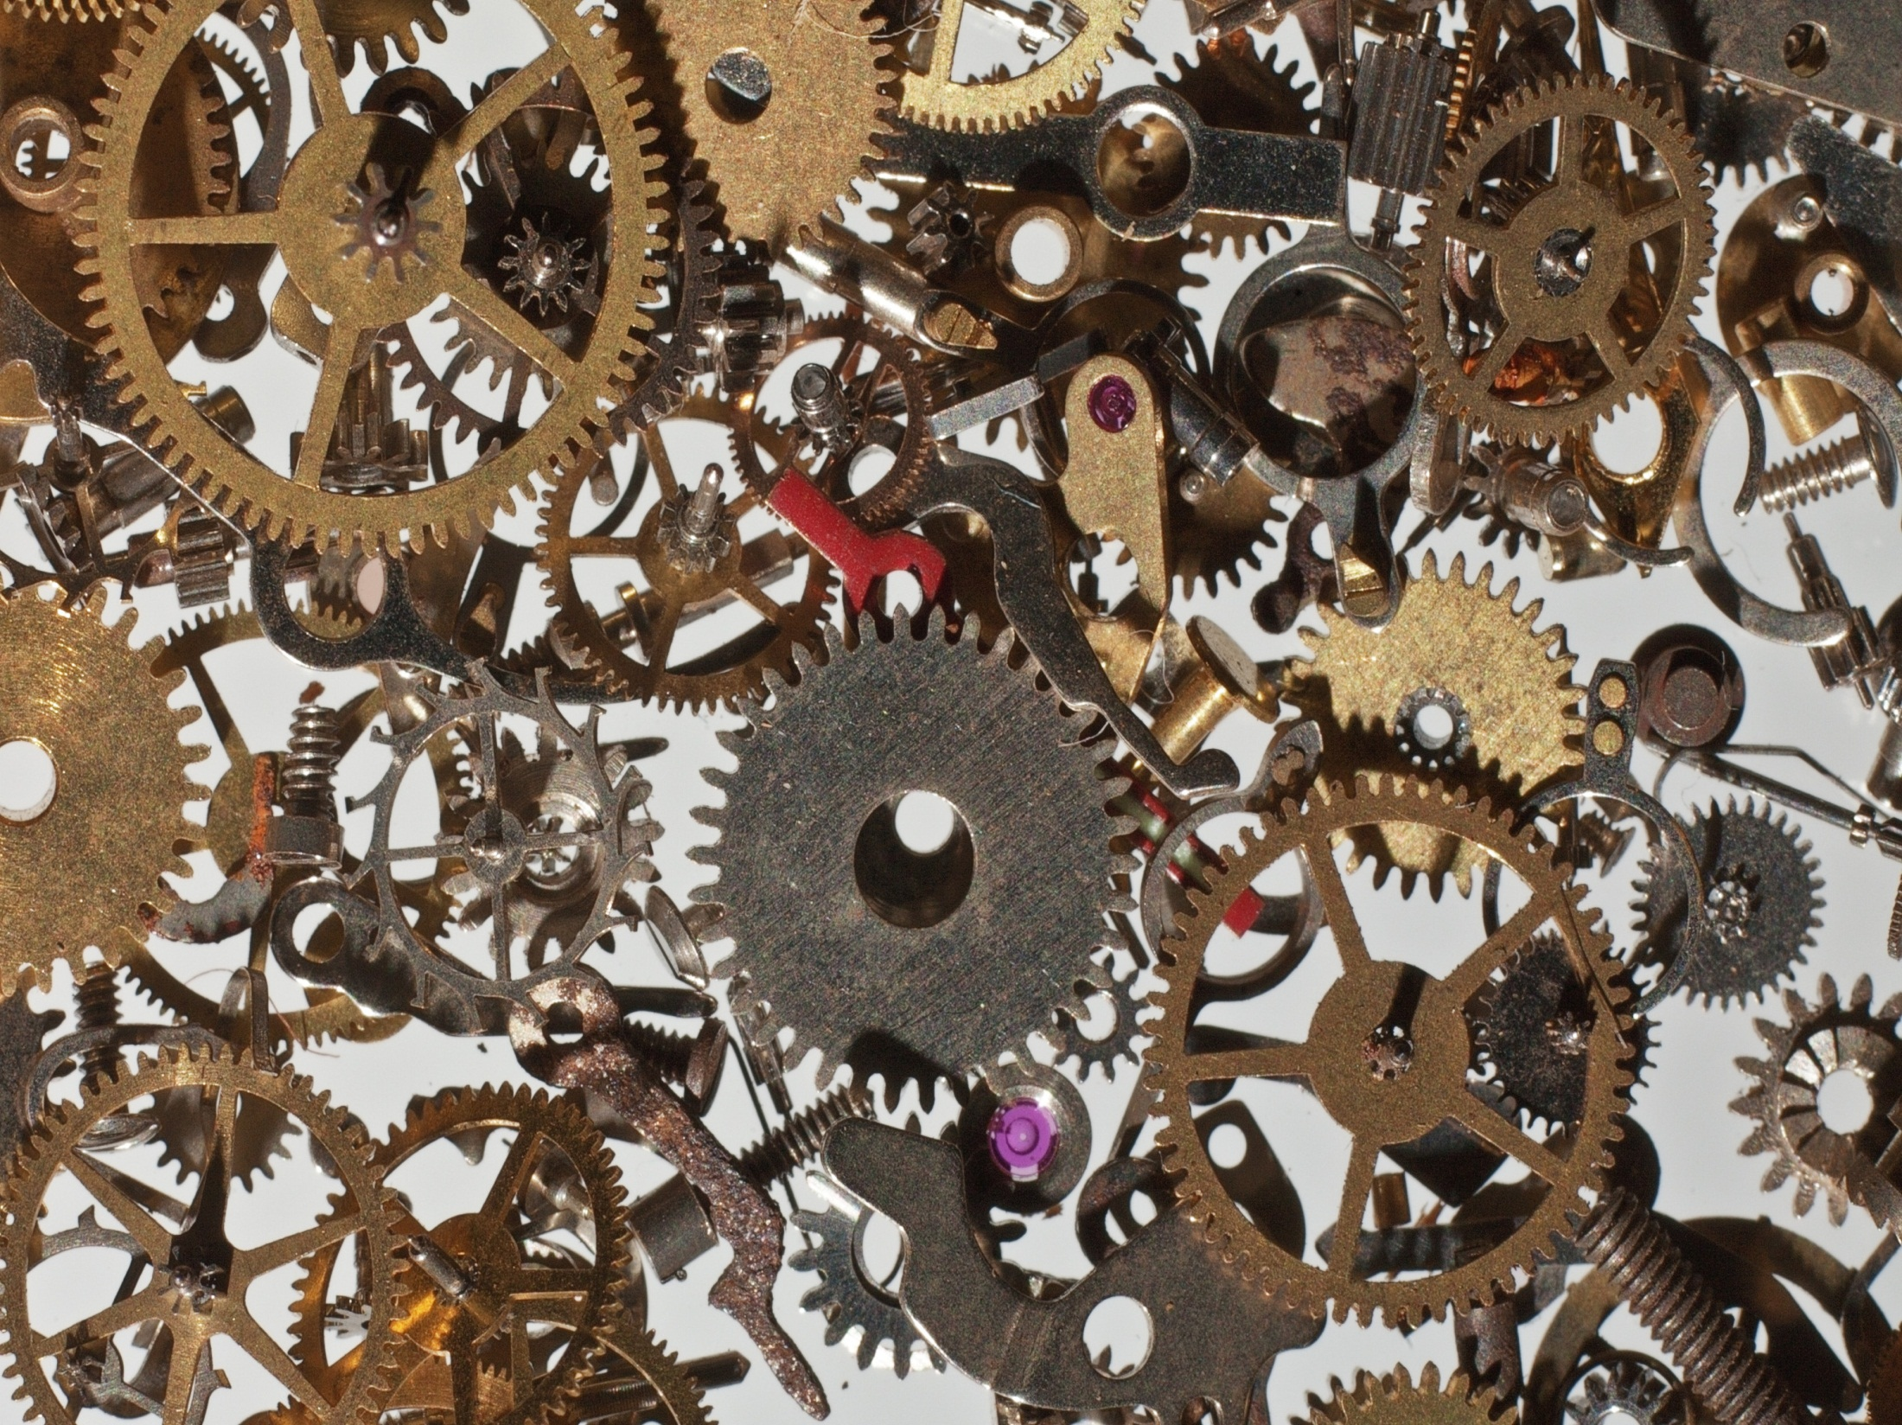

Slide 20
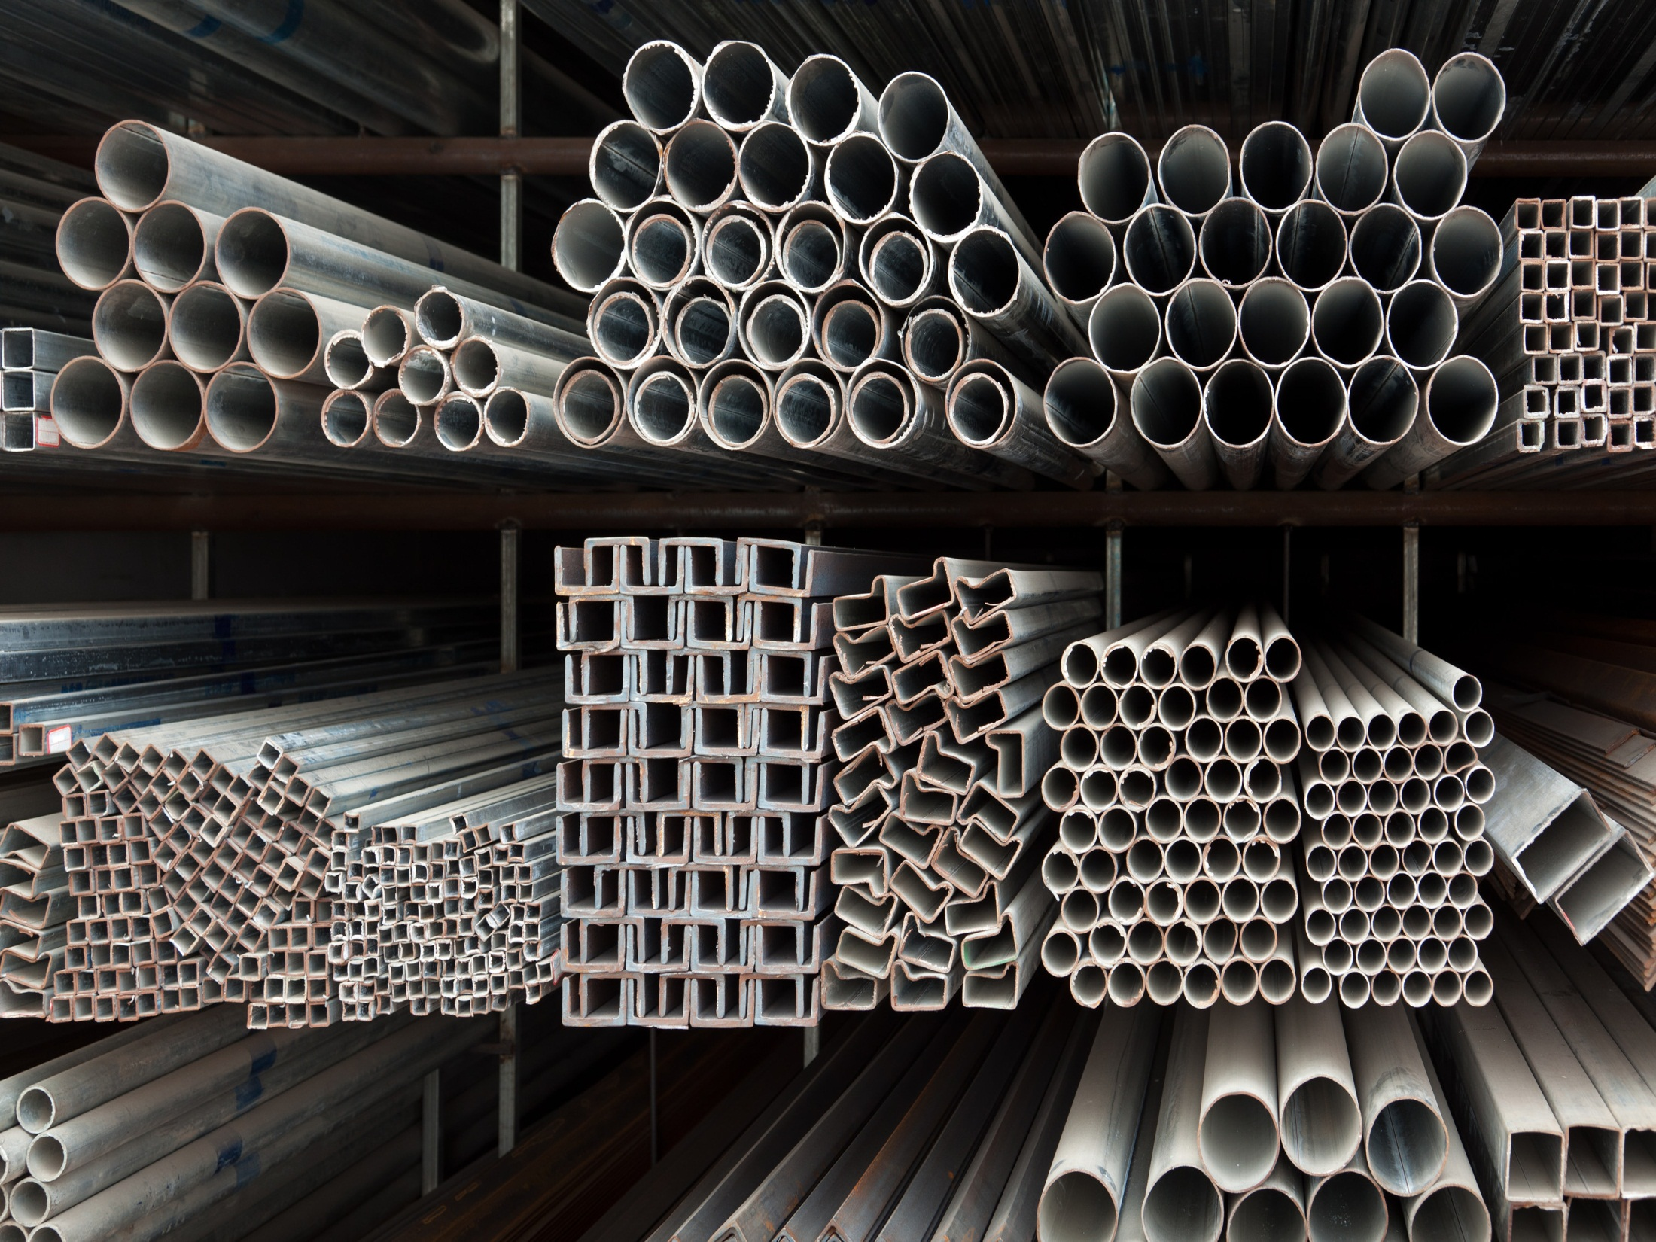

Slide 21
74.6%
74.0%
70.9%
68.6%
70.8%

Slide 22
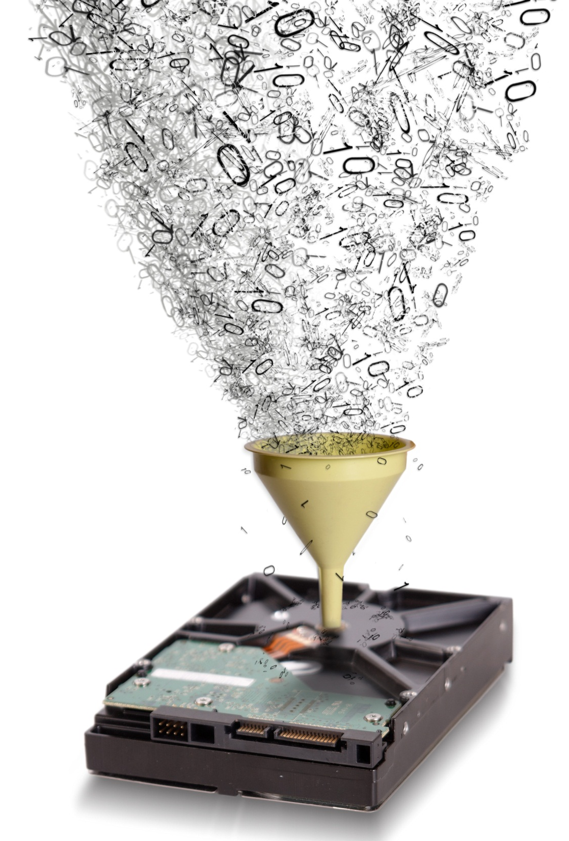

Slide 23
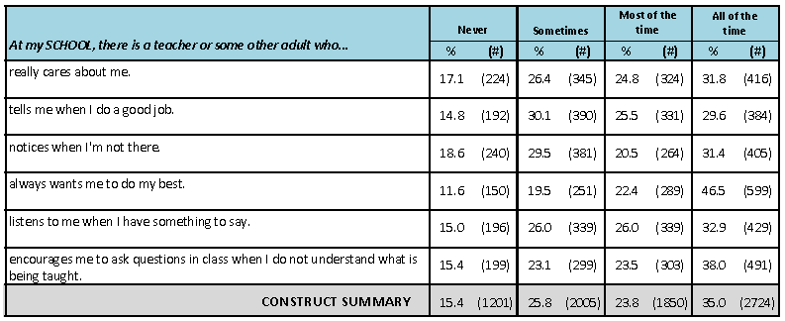

Slide 24
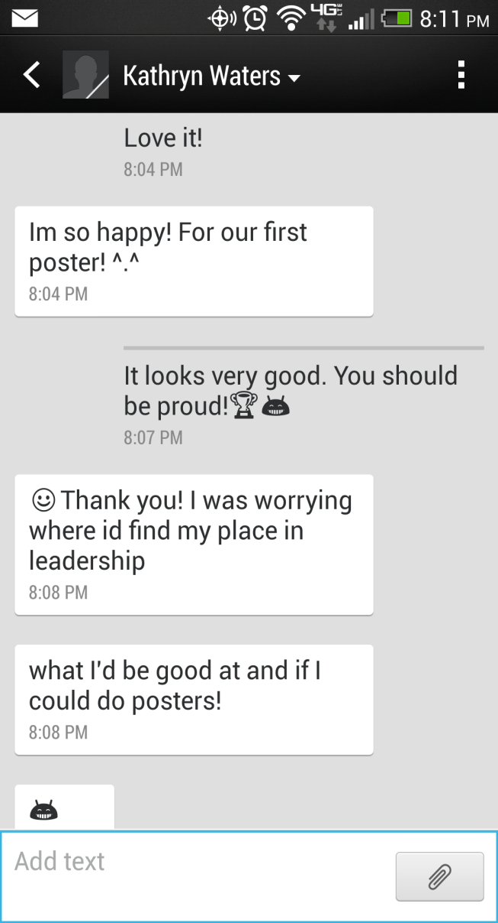
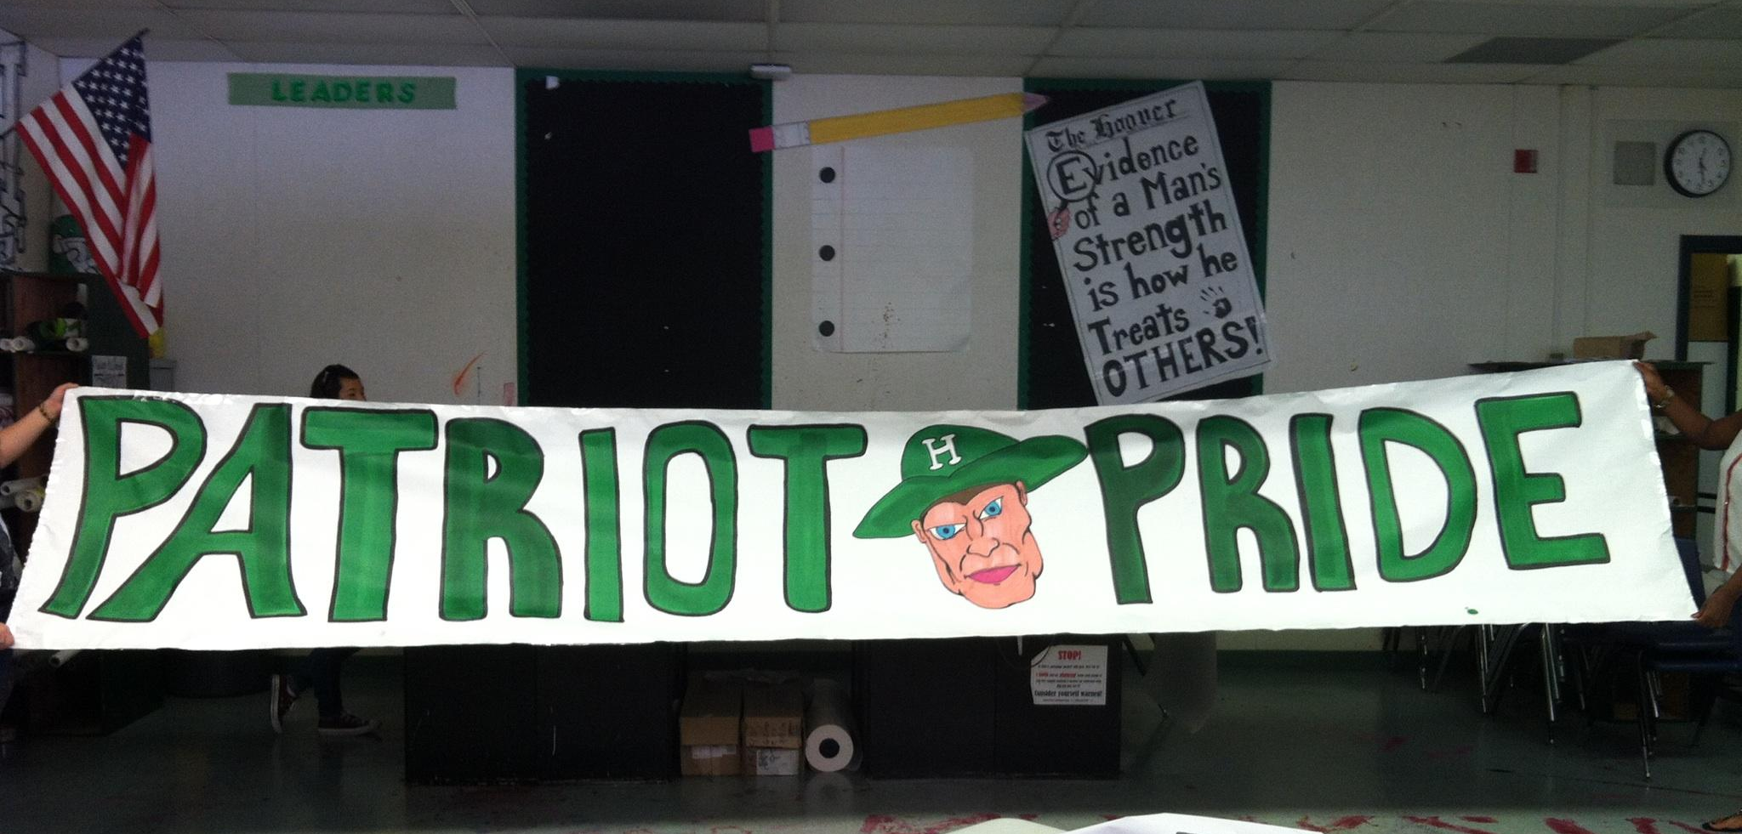
What are WE going to do about it?
How are WE going to
change the Culture?

Slide 25
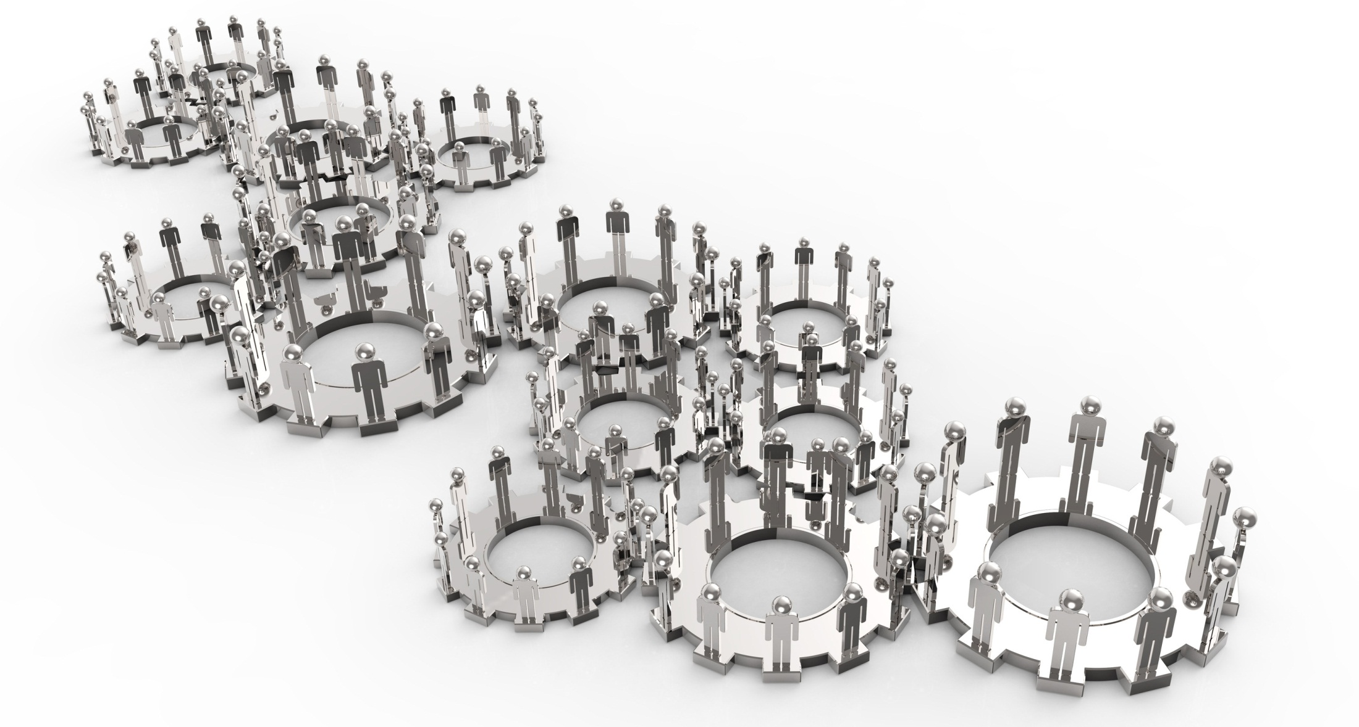

Slide 26
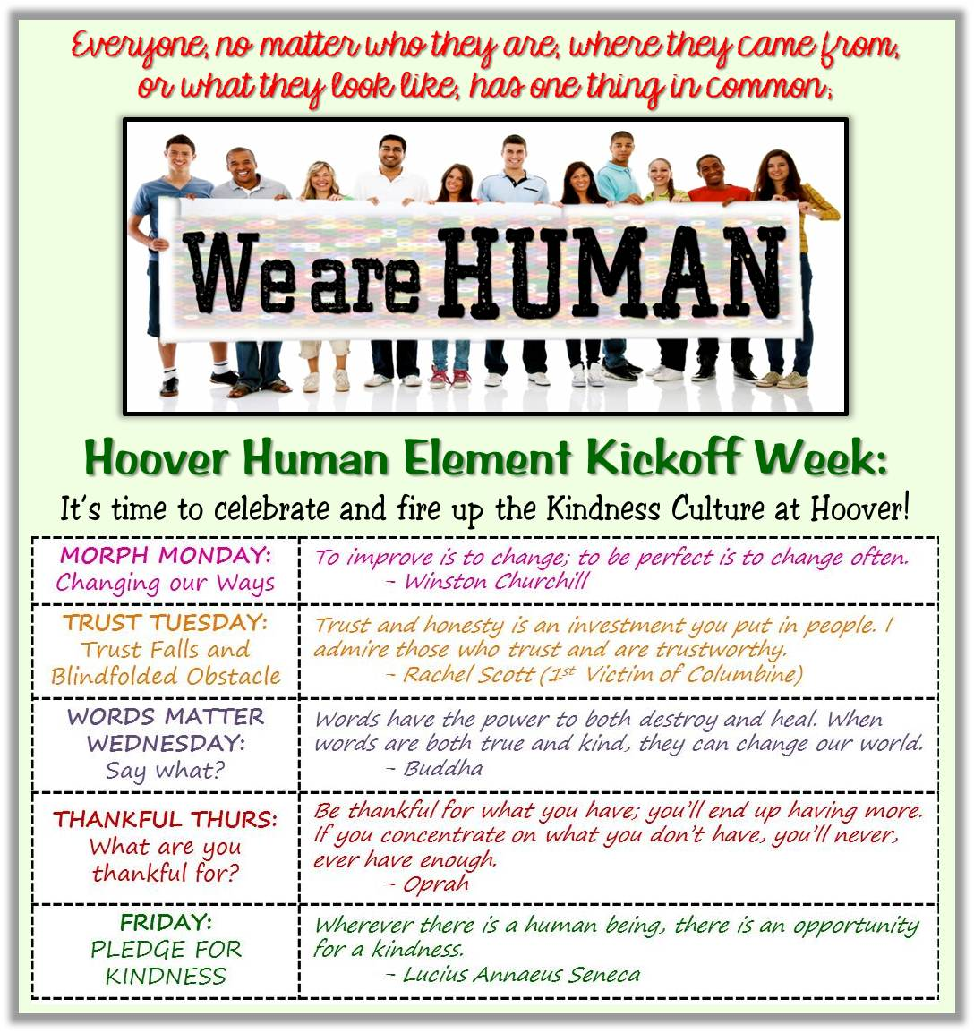

Slide 27
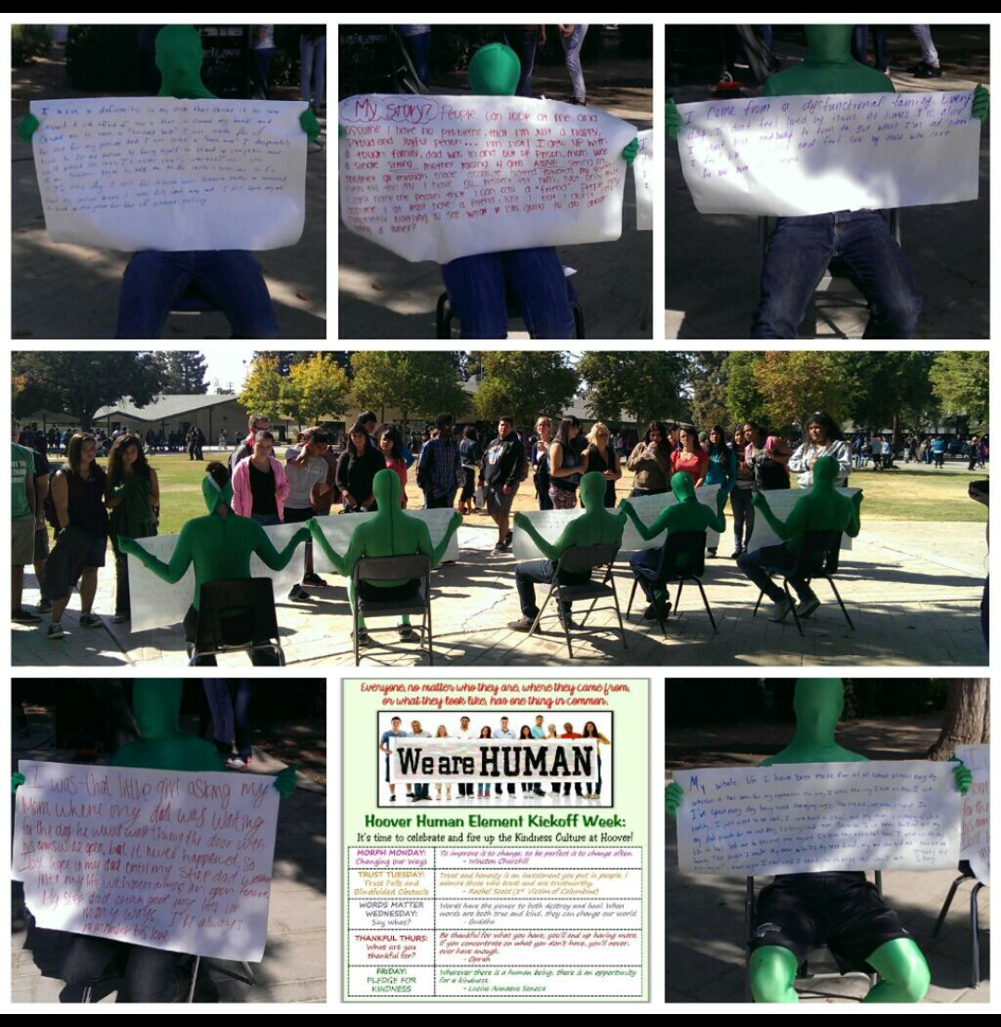

Slide 28
HUMANKIND
Be Both.
2013-14
Human Element

Slide 30
HUMANKIND
Be Both.
Human Element
PSA
Human Element
Wrap-up

Slide 32
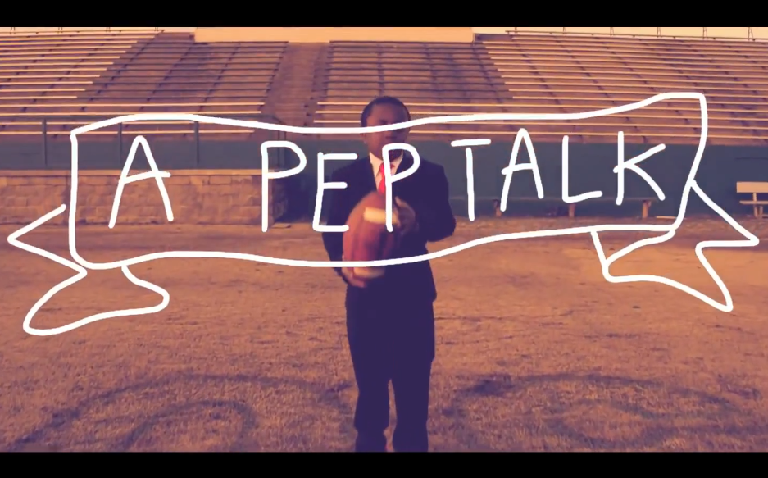

Slide 33
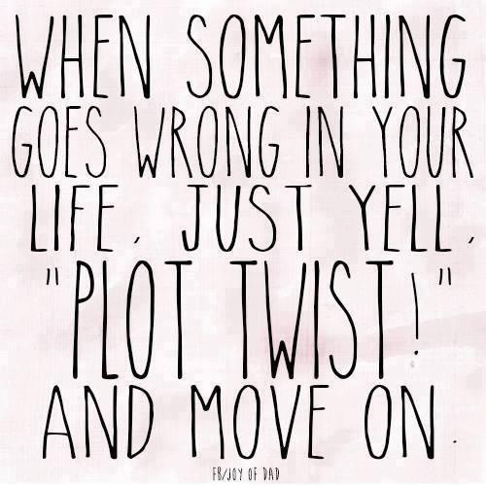

Slide 34
HUMANKIND
Be Both.
Wall
Of Words
Power
Of Words

